Slide 1

My Personal AI Assistant
A Python-based Voice-
Controlled App
[soroj kumar panda]

Slide 2

Introduction: Bringing AI to Your Desktop
My project is about creating a smart desktop voice assistant using Python.It can listen to what we say, understand the command, and give the answer on screen — just like a real AI assistant.The main aim is to make computer interaction simple and natural.
It mainly focuses on:-
Understanding spoken commands,
Performing different tasks based on those commands,
andShowing clear text responses.

Slide 3

Core Features & Expanding Capabilities
Real-time Information
My assistant can tell the current time and show live weather updates for any city using online APIs.
Productivity & Web Access
It can open YouTube or any website just by giving a voice command, making browsing easier.
Knowledge Retrieval
It can search Wikipedia and give short answers on different topics.
Entertainment & Media
Using pywhatkit, it can play any song on YouTube, acting like a personal DJ.
Memory & Note-Taking
It uses an SQLite database to save and show personal notes, so important information is never lost.

Slide 4
The Robust Technology Stack
Our AI assistant is built upon a foundation of powerful and versatile open-source technologies, ensuring both functionality and extensibility.
Core Language: Python
Python is the main language used because it’s easy to read, has many useful libraries, and has a large community for support.
Voice I/O:
speech_recognition
The "Brain" (NLP): Scikit-learn
It uses TF-IDF Vectorizer and Logistic Regression to understand the meaning of user commands.
&
pyttsx3
speech_recognition is used to convert voice to text (listening).pyttsx3 can be used for text to speech (replying by voice). (In my project, only listening is used.)
Database: SQLite3
Used to store and retrieve notes or personal data locally and efficiently.
Web Integration:
requests
,
webbrowser
,
wikipedia
,
pywhatkit
pywhatkitThese libraries help the assistant to get online data, open websites, search Wikipedia, and play YouTube songs.

Slide 5


Operational Logic: How It Works
My AI Assistant follows a simple process of listening, understanding, and acting.
1. Listen for Command
The assistant takes voice input from the microphone and waits for a command.
Understand (NLP)
The speech is converted into text, and the Logistic Regression model predicts what the user wants to do.
Execute Action
According to the predicted intent, the assistant runs the correct function — like checking weather, opening YouTube, or showing notes.
Respond Verbally
Finally, it shows the result on screen (and can also reply by voice if enabled).

Slide 6
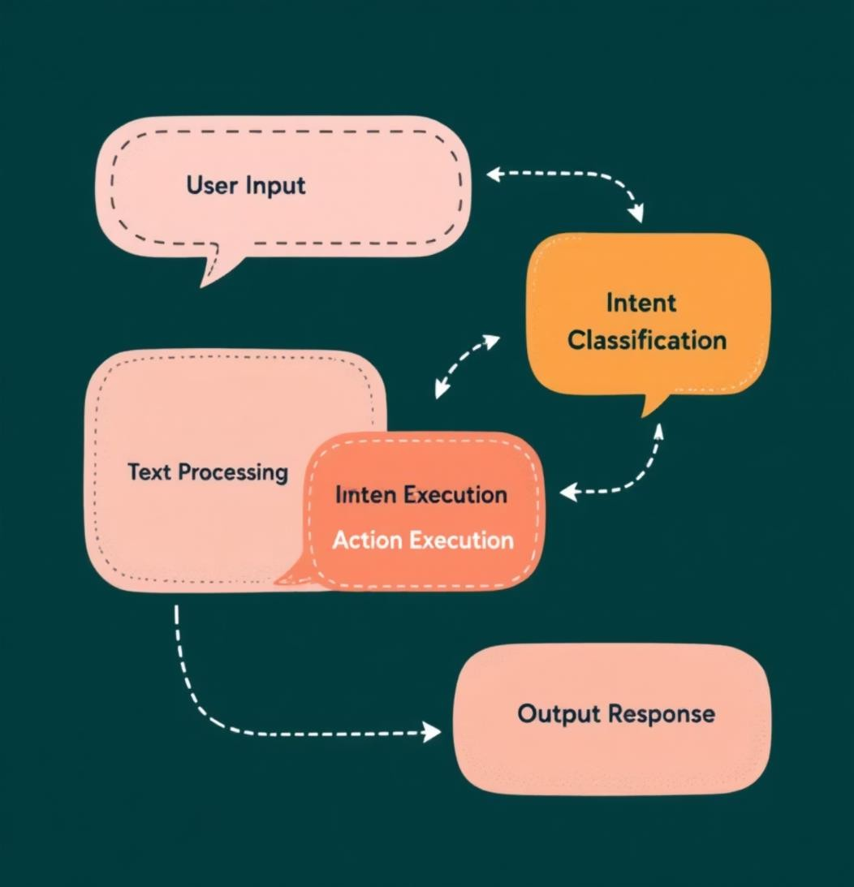
Deep Dive: Natural Language Processing
The main power of my assistant comes from Natural Language Processing, or NLP, which helps it understand what the user says.
From Speech to TextWhen we speak, the speech recognition library changes our voice into text.
From Text to Meaning (Intent Detection)That text is sent to a trained NLP model.The TF-IDF Vectorizer converts the words into numbers based on their importance.Then, a Logistic Regression model reads those numbers and decides what the user wants to do, such as “play song,” “get weather,” or “set note.”
In short, the assistant converts speech → text → intent → action.

Slide 7

Data Management: The SQLite Heart
Efficient data handling is crucial for personal assistants, especially for features like note-taking.
Secure & Local Note Storage
My assistant uses SQLite, a simple file-based database that keeps all data safely on the local system.
Simple: No server setup is needed — easy to use and manage.
Portable: All data is stored in one single file, so it’s easy to move or back up.
Reliable: It is ACID-compliant, which means it keeps data safe and accurate.
So, users can save and view notes anytime, and their information stays secure and local — not on the internet.

Slide 8




Web Connectivity & External Services
Apart from local tasks, my assistant can also connect to the internet and use online data
1. requests: Used to get real-time data from the internet, like weather information through APIs.
2. webbrowser: Helps to open websites directly in the computer’s default browser — for example, YouTube or any link the user says.
3. Wikipedia: Allows the assistant to search topics on Wikipedia and show short, useful information.
4. pywhatkit: Used to play any song on YouTube automatically based on the user’s command.

Slide 9
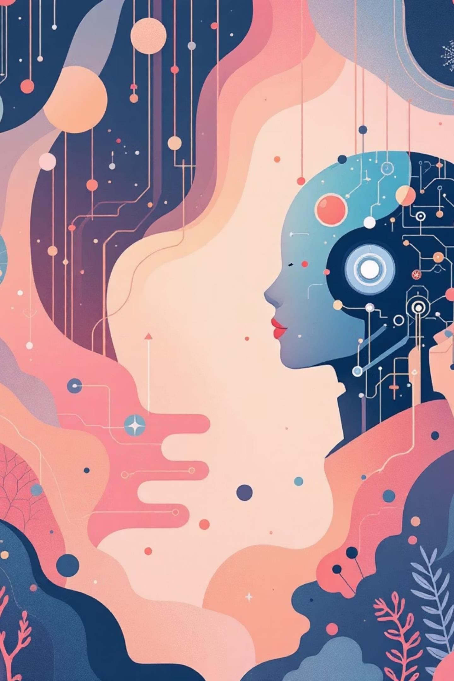
Conclusion: A Stepping Stone to Advanced AI
This project is a successful example of combining different computer technologies to create a working AI Personal Assistant.
Project Summary
We built a Python-based assistant that canUnderstand voice commands,Use NLP for intent prediction, Manage data using SQLite, and Connect to the internet for real-time information.
Future Enhancements
Add a Graphical User Interface (GUI) for a better user experience.Add more features and skills to make the assistant smarter .Use advanced machine learning models (like neural networks) to improve understanding and accuracy.

Slide 10
Thank You & Questions

